Slide 1
Transboundary Conservation Areas
Lesson 7
Initiating transboundary conservation: Design the process II: Negotiate a joint vision and develop management objectives
Notes:
Photo Credit: Dzanga-Ndoki National Park Rainforest Reserves in the Central African Republic ©Peter Prokosch
*Note that all of the photos in this presentation are of the Sangha Trinational World Heritage Site shared by Cameroon, Central African Republic and the Republic of Congo.
Context and purpose of Lesson 5
This lesson continues the discussion of the second stage of the transboundary conservation process: Design the process. It focuses on the final step of that stage: negotiate a joint vision. The purpose of the lesson is to:
Introduce learners to initiating and negotiating a joint vision and developing management objectives for transboundary conservation initiatives
Help develop understanding of the nature of cooperative management and approaches to developing management objectives
Practice negotiating a joint vision and developing management objectives
Supplemental Reading
IUCN WCPA Best Practice Guidelines Transboundary Conservation: A systematic and integrated approach (Pgs. 65–69)
IUCN Initiating effective transboundary conservation: a practitioner’s guideline based on the experience from the Dinaric Arc (Pgs. 24–41)
IUCN Guidelines for Protected Areas Legislation (PA Guidelines) (Pgs. 270–271, 280–292)

Slide 2
Factors of Success
Assess the enabling environment to pursue transboundary conservation
Define the transboundary context and relationships affecting the achievement of the conservation targets and the resulting geographic extent
Identify and involve stakeholders, obtain support of decision makers and ensure political will and buy-in
Agree on common values and joint vision
Determine common transboundary management objectives and develop cooperative agreements
Notes:
Photo Credit: Dzanga-Ndoki National Park Rainforest Reserves in the Central African Republic ©Peter Prokosch
Factors of success
Recall the five factors of success in the process of initiating transboundary conservation:
1. Assess the enabling environment to pursue transboundary conservation
2. Define the transboundary context and relationships affecting the achievement of the conservation targets and the resulting geographic extent
3. Identify and involve stakeholders, obtain support of decision makers and ensure political will and buy-in
4. Agree on common values and joint vision
5. Determine common transboundary management objectives and develop cooperative agreements
Lesson 2 introduces key concepts, models and approaches relevant to all five factors.

Slide 3
Lesson Overview & Goals
Initiating Transboundary Conservation: Design the Process II
Developing a framework for cooperative management
Management planning workshop
Notes:
Photo Credit: Dzanga-Ndoki National Park Rainforest Reserves in the Central African Republic ©Peter Prokosch
Content overview
This Lesson will address:
Practical approaches and processes for developing a framework for cooperative management
Content and structure of management planning workshops

Slide 4
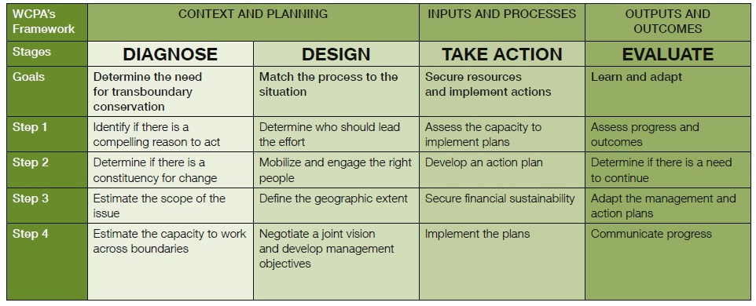
Design: Match the Process to the Situation
Notes:
Photo Credit: Dzanga-Ndoki National Park Rainforest Reserves in the Central African Republic ©Peter Prokosch
Design: Match the process to the situation
Refer to the transboundary conservation process introduced in Lesson 1.
Recall that the process involves four stages:
Diagnose
Design
Take Action
Evaluate
Lesson 3 addressed the first stage: Diagnose. Lesson 5 introduced the second stage: Design.
This Lesson continues with the second stage: Design, which includes the following steps:
Determine who should lead the effort
Mobilize and engage the right people
Define the geographic extent
Negotiate a joint vision and develop management objectives
This Lesson will focus on the final step: “Negotiate a joint vision and develop management objectives”
Again, it is important to remember that these steps are iterative – they do not necessarily happen in this order, and there may be a need to return to and review different steps in the process.

Slide 5
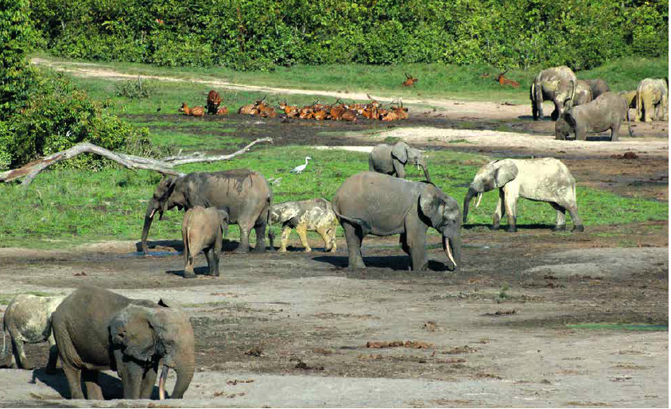
Cooperative Management
Cooperative management is taking action together to implement decisions and pulling together the available means to reach the agreed aim/results.
In a transboundary context cooperative management involves international cooperation
Cooperative management requires:
Shared understanding of the issues
Common vision
Agreed management objectives
Means of implementation
Incorporation of different sectors
Participation of relevant stakeholders
Notes:
Photo Credit: Dzanga-Ndoki National Park (Central African Republic), forming part of the Sangha Trinational ©Boedhihartono Intou
Cooperative management
Lesson 6 introduced cooperative management.
Recall from Lesson 6:
Cooperative management is taking action together to implement decisions and pulling together the available means to reach the agreed aim/results. Cooperative management relies upon a shared understanding of the issues, common vision, agreed objectives and a means to deliver transboundary conservation.
This often includes cooperation between different sectors, levels of government and stakeholder groups.
In a transboundary context, cooperative management involves stakeholders from two or more countries with a common interest in the conservation of a shared ecosystem or species, cooperating formally or informally.
In this module, cooperative management is always used in the context of transboundary cooperation and never within one single country.

Slide 6

Management Planning Workshop
A management planning workshop brings together stakeholders relevant for a transboundary initiative to:
Negotiate a common vision
Develop a shared understanding of the issues
Identify management challenges
Develop a framework for cooperative management
Notes:
Photo Credit: Dzanga-Ndoki National Park: African Forest Elephants (Loxodonta cyclotis) ©Peter Prokosch
Management planning workshop
A common way to begin the process of cooperative management is through a management planning workshop.
A management planning workshop brings together stakeholders relevant for a transbundary initiative to:
Negotiate a common vision
Develop a shared understanding of the issues
Identify management challenges
Develop a framework for cooperative management
A management planning workshop normally would require 3 or more days.
Note that a management planning workshop does not necessarily result in a framing of a joint management plan. As discussed in Lesson 6, there are many strategies for cooperative management, and in practice it is rare to have a fully combined management plan. However, joint management planning can help agree on a common vision and set of objectives that can inform management plans in areas on either side of the border.

Slide 7
Management Planning Workshop
Suggested agenda for a management planning workshop
Presentations: on the rationale for a common transboundary initiative, relevant international, national and policy frameworks, policy compatibilities, perspectives of various stakeholders
Open and facilitated discussion: clarification points
Situation analysis: identifies all internal and external aspects relevant to the establishment and management of the transboundary conservation initiative (natural, cultural, economic, social, political)
Plenary brainstorming: sessions to start developing a shared vision, identifying broad management objectives, and possibly prioritizing the objectives
Next steps: agree leadership and accountability (who does what and when)
Notes:
Management planning workshop
Management planning workshop is usually led by a trained facilitator and should generally include the following elements:
Presentations - on the rationale for a common transboundary initiative, relevant international, national and policy frameworks, policy compatibilities, perspectives of various stakeholders
Open and facilitated discussion – participants add to what has been presented and ask clarification questions
Situation analysis - identifies all internal and external aspects relevant to the establishment and management of the transboundary conservation initiative (natural, cultural, economic, social, political)
Plenary brainstorming - sessions to start developing a shared vision, identifying broad management objectives, and possibly prioritizing the objectives
Next steps - agree leadership and accountability (who does what and when)
Table 16 on p. 65 of the Best Practices Guidelines provides an example agenda for a management planning workshop. This table can be distributed to learners as a handout.

Slide 8
Framework for Cooperative Management
The management planning workshop can form the basis of a framework for cooperative management
Main outputs of the management planning workshop:
Common vision statement
List of (prioritized) common management objectives (where and when to cooperate)
Roles and responsibilities
Major components of a potential
future joint management plan
Notes:
Framework for cooperative management
The management planning workshop can form the basis of a framework for cooperative management.
Main tangible outputs of the workshop include:
Negotiated common vision statement
List of (prioritized) common management objectives with clear indication of where and when the parties will cooperate
Determined roles and responsibilities
A common vision statement and management objectives form a framework for transboundary cooperative management
These outputs are considered as major component of a potential future joint management plan or other management framework
Joint management plans are the best mechanism for ensuring effective implementation and enforcement of conservation goals, but they are not always possible in reality
In all cases, the workshop can help develop agreement on a common vision and management objectives which can inform harmonization of management activities in practice

Slide 9
Framework for Cooperative Management
Framework for Common Transboundary Management
Vision statement
Goal
Key result area (example)
Enabling environment
Landscape management
Effective management capacity
Law enforcement
Education and awareness
Economic development
Financial sustainability
Strategic objective (example)
1.1. Laws and policies harmonized by year XX
2.1. Connectivity ensured by year XX
3.1. Coordinated planning and monitoring by year XX
4.1. Formal collaborative law enforcement mechanism to control illegal activities established by year XX
5.1. Positive attitudes towards conservation by year XX
Notes:
Framework for cooperative management
This slide provides an example framework for transboundary management, that could result from a management planning workshop
Vision statement
Goal
Key result areas and Strategic objectives: examples are provided for the first five exemplary key result areas:
1. Enabling environment - 1.1. Laws and policies harmonized by year XX
2. Landscape management - 2.1. Connectivity ensured by year XX
3. Effective management capacity - 3.1. Coordinated planning and monitoring by year XX
4. Law enforcement - 4.1. Formal collaborative law enforcement mechanism to control illegal activities established by year XX
5. Education and awareness - 5.1. Positive attitudes towards conservation by year XX.
Table 17 on p. 66 of the Best Practice Guidelines includes an example of a framework for cooperative management: the framework for common transboundary management in the Central Albertine Rift. This can be distributed to learners as a handout.

Slide 10
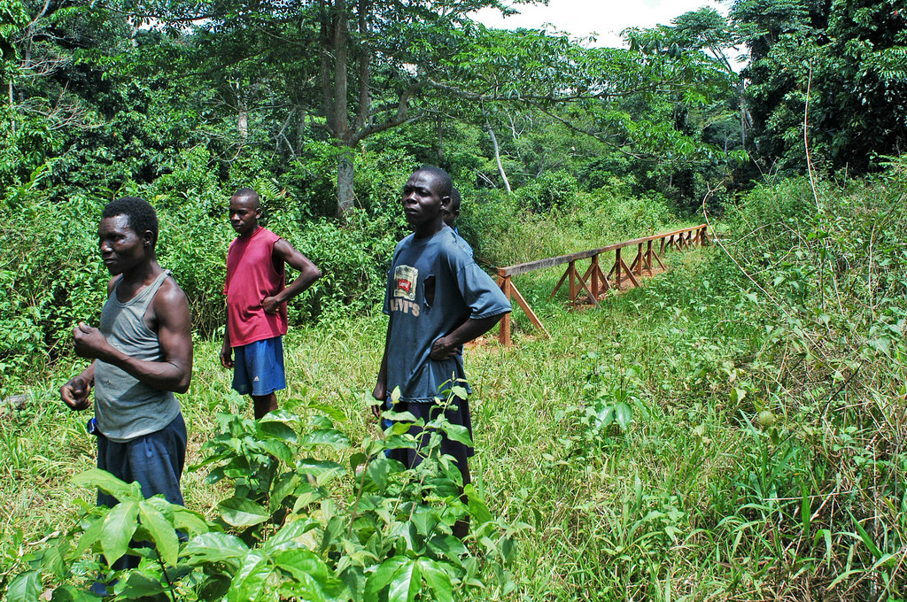
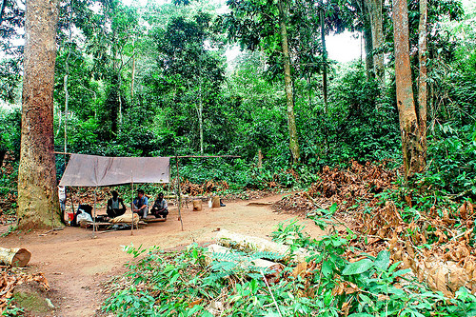
Management Planning Workshop
Main outputs of the management
planning workshop that may be less visible:
Building of mutual trust and relationship
Creation of ‘ownership’ of the initiative
Reaching a shared understanding of the issues
Notes:
Photo Credit: Dzanga-Ndoki National Park: BaAka Rangers in Dzanga-Ndoki National Park, Central African Republic ©Peter Prokosch (top); Dzanga-Ndoki National Park: Field Camp of BaAka Rangers in Dzanga-Ndoki National Park, Central African Republic ©Peter Prokosch (bottom)
Management planning workshop
In addition to the tangible outcomes of the workshop – the vision and management objectives – a management planning workshop normally results in less visible outputs, including:
Building of trust and relationship
Creation of ownership of the transboundary conservation initiative
Reaching a shared understanding of the issues

Slide 11
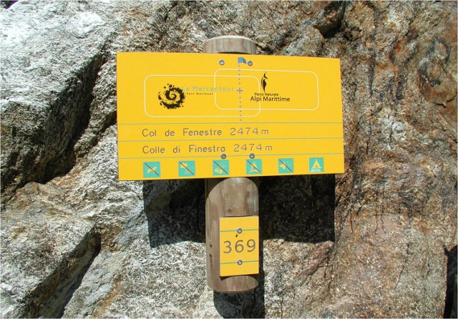
Marittime Alps-Mercantour: Common Cooperative Framework
1987 Twinning Agreement enabled joint conservation management activities
Extensive use of EU INTERREG funds – 17 joint projects
1998 Twinning Charter – priorities for transboundary conservation identified
2006 Common Action Plan adopted
2013 Joint governance structure under the European Grouping of Territorial Cooperation programme
2013 Marittime-Mercantour Integrated Transboundary Plan
Notes:
Photo Credit: A common signpost in the Marittime Alps-Mercantour ©PNPG Archive Marco di Lenardo (Taken from IUCN BPG, 2015, pp.68)
Marittime Alps-Mercantour: Common cooperative framework
The Marittime Alps-Mercantour is an example of the development of a common cooperative framework.
The area consists of the contiguous Marittime Alps Regional Park, Italy, and Mercantour National Park, France. (Note that a ‘contiguous protected areas across international boundary’, as defined in Glossary, indicate protected areas adjoining across international boundary) The site has a long history of cooperation and is one of the best practice examples in transboundary conservation with a very advanced and efficient cooperation and governance.
In 1987, a twinning agreement was signed between the two parks with the aim to undertake joint management activities in conservation and sustainable development, e.g. projects on strengthening the population of ibex (Capra ibex), reintroduction of bearded vulture (Gypaetus barbatus), and monitoring of the wolf (Canis lupus). More ambitious projects followed with the EU INTERREG support (17 projects, total value 10 million EUR, e.g. projects on common signposting system, enhancement of a transboundary mountain trail, scientific research). In 1998, they signed a new, more structured Twinning Charter, in which priority actions were identified for transboundary conservation and sustainable development.
In 2006, a Common Action Plan was adopted to formalize cooperation. Following that, joint governance structure was established in 2013 using the EU instrument - the European Groupping of Territorial Cooperation (EGTC). EGTC is the first European cooperation structure that allows public entities to establish a new body with full legal personality, as defined by European Law. Marittime-Mercantour Integrated Transboundary Plan was adopted in 2013.
Supplemental reading:
Marzo, D., Niccolini, F., Rossi, P. and Brandeis, A. (2015). Case study 8: The challenge of developing a shared vision: Marittime Alps-Mercantour. In: Vasilijević, M., Zunckel, K., McKinney, M., Erg, B., Schoon, M., Rosen Michel, T. Transboundary Conservation: A systematic and integrated approach. Best Practice Protected Area Guidelines Series No. 23, Gland, Switzerland: IUCN.

Slide 12
Practical Exercise 3: Negotiating a Joint Vision
Purpose
Structure
Understand challenges posed by negotiating common vision
Introduction (20 minutes)
Group work (30 minutes)
Practice determining transboundary management objectives
Mock negotiation (60 minutes)
Build capacity to initiate cooperative arrangements
Consolidation (10 minutes)
Notes:
Photo Credit: View from Bangui/Central African Republic, over the Ubangi River to the Democratic Republic of the Congo ©Peter Prokosch
Practical exercise 3: Negotiating a joint vision
Refer to the Exercise 3: Negotiating a Joint Vision
Purpose:
Understand challenges posed by negotiating a common vision
Practice determining transboundary management objectives
Build capacity to initiate cooperative arrangements
Structure:
Introduction to Exercise (20 minutes)
Group work (30 minutes)
Joint class discussion (60 minutes)
Consolidation (10 minutes)
Refer to the Exercise Instructions for specific mandates for each group. You will have 30 minutes to prepare, followed by 60 minutes for the negotiation itself.

Slide 13
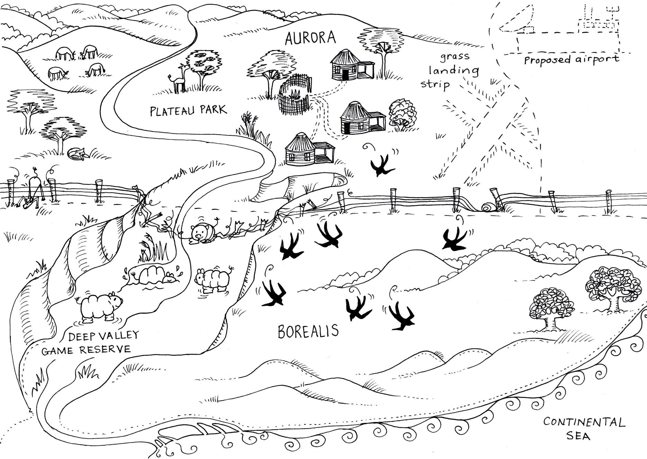
Practical Exercise 3: Negotiating a Joint Vision
Notes:
Photo Credit: View from Bangui/Central African Republic, over the Ubangi River to the Democratic Republic of the Congo ©Peter Prokosch
Practical exercise 3: Negotiating a joint vision
The Case Study:
Full details of the case study are provided in Exercise 3 Instructions and Annexes for participants
This slide provides a map for learners to refer to. They also have copies of the map in their groups

Slide 14
Practical Exercise 3: Negotiating a Joint Vision
Preparation (30 minutes)
Negotiation (60 minutes)
1. Designate topic leads
10 minutes per topic
2. Read the case study and group instructions
Discussion, informal statements
3. Prepare a strategy
Broad agreement, not specific language
Understand your own priorities and limitations
Anticipate what other groups will bring to the discussion
Notes:
Photo Credit: Dzanga-Ndoki National Park Rainforest Reserves in the Central African Republic ©Peter Prokosch
Practical exercise 3: Negotiating a joint vision
Specific instructions are included in the instructions for each group.

Slide 15
Transboundary Conservation Areas
End of Lesson 7
Notes:
Photo Credit: Dzanga-Ndoki National Park Rainforest Reserves in the Central African Republic ©Peter Prokosch

